Slide 1

Canteen Ordering System
Theme- SDG Goals : SDG 9 (Industry,Innovation and Infrastructure) AND SDG 12 (Responsible Consumption and Production)
Category- Software
Group No - 10
Group Members- Vedang Karmalkar (24106004)
Vinay Handge (24106114)
Suraj Gupta (24106049)
Prince Gupta (24106087)
Guide- Prof. Vijaya Bharathi Jagan

Slide 2
Introduction
Currently, students must physically go to the counter to place orders and pay.
The process relies entirely on manual ordering and waiting near the counter.
Recess breaks are short, and students need to eat quickly to return to class.
Lunch breaks should be for relaxing and eating, not for struggling in a crowd.
Overcrowding: The counter gets blocked by students waiting to order or collect food.
Wasted Time: A large part of the break is lost just standing in the queue.
Confusion: Without a display system, students have to ask staff repeatedly if their food is ready.

Slide 3
Objectives
To bridge the gap between students and canteen administration via a web-based platform
To reduce manual billing errors and miscommunication.
To eliminate long queues during peak break hours.
To enable students pre-order and schedule food pickup.
To improve overall efficiency of canteen operations.

Slide 4
Literature Survey
Author & Year | Techniques used | Dataset Used | Key Results | Limitations
Kale,R.B,R.k,& Gawai,V.B 2020 | Android based food ordering system with Raspberry pi,XAMPP database. | Real-time order data generated from student orders via app. | Reduced queue waiting time,Faster processing compared to manual system. | Requires specific hardware installation (Raspberry Pi/Screens) at the counter.
Antony C,Biju,A Kuriakose & Jismon, 2022 | Web based canteen system,OTP login,online payment | Real-time user & order data(no public dataset mentioned) | Digital payment tracking,User feedback system | No real time track, no token id generation
P Bari, T Suroshe,N Sathawne,Y Patil, 2024 | Web based system,QR code login,Online payemnt | Real time canteen order data. | Reduced queues,Faster billing,Digital records | Limited scalability discussion,no multi-canteen support.

Slide 5
Literature Survey
Author & Year | Techniques used | Dataset Used | Key Results | Limitations
Katkar, A. & Jangale, S. (2018) | System with built-in "E-Wallet" and AES 128-bit encryption for security. | Real-time user transaction data (Students & Staff records). | Replaced cash with a secure digital wallet. Reduced queue time significantly by removing change/cash handling. | Requires users to pre-load money into a specific "closed" wallet system.
Bhattarai et al. (2024) | QR-Code based system for menu viewing and ordering. | Real-time transactional data generated by the system | Simple to implement; reduces need for printed menus. | No Pre-Scheduling: Users can only order now; they cannot "Schedule" a pickup for a future break time.

Slide 6
Limitations of Existing Systems
High Hardware Cost: Many existing automated solutions require expensive proprietary hardware (like RFID readers, Kiosks, or Raspberry Pi screens) that are costly to install and difficult to maintain.Our proposed system focuses on the web portal.
No real-time order status tracking, forcing them to wait anxiously at the counter and repeatedly ask staff. . Our proposed system overcomes this by providing real time order status to the customer which improves transparency.
Existing systems do not support integration of multiple canteens. Our proposed system focuses on solving this problem.
Existing system have only digital wallet only for payment method. Our proposed system have both UPI payment and digital wallet
Unlike existing systems that only allow immediate ordering, our system introduces Flexible Pre-Scheduling. This allows students to order food in advance for any specific break time during canteen hours.

Slide 7
Problem Statement
Problem Statement: Currently, the campus canteen operates on a manual system that leads to severe overcrowding and chaos during peak recess hours. Students waste significantly limited break time standing in long queues to place orders and pay via cash. The lack of a digital tracking system results in confusion at the counter, frequent billing errors by staff, and unmanaged food inventory that increases wastage.

Slide 8
Proposed Methodology
System Overview:
Our project is a Smart Canteen Food Ordering System.
It is a web-based application that allows students to order food online, pay digitally, and track their order status without standing in line.
It solves the problem of overcrowding and makes the canteen process faster and paperless.
Existing System (Limitations) | Proposed System (Our Solution)
High Hardware Cost: Requires expensive RFID, kiosks, Raspberry Pi screens. | Low Cost Web Portal: Works on any browser without extra hardware.
No Order Tracking: Students repeatedly ask staff for status. | Real-Time Tracking: Live order status updates for customers.
Single Canteen Support: Cannot manage multiple canteens | Multi-Canteen Integration: Supports multiple canteens in one system.
Limited Payment Options: Only digital wallet available. | Multiple Payments: Supports UPI and digital wallet.
Immediate Ordering Only: Cannot order in advance. | Flexible Pre-Scheduling: Order food for any break time in advance.

Slide 9
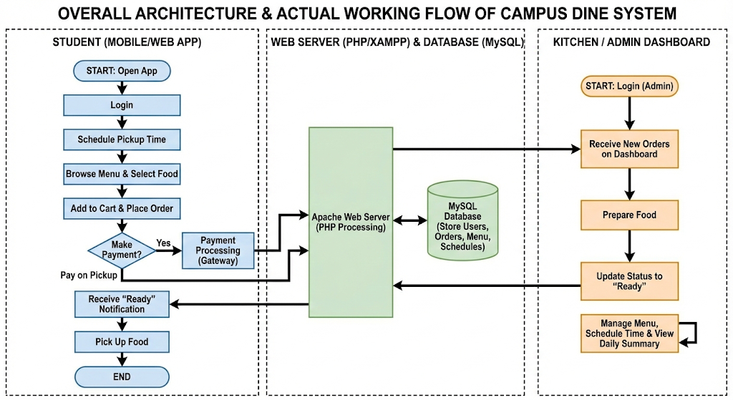
Proposed Methodology

Slide 10
EXPERIMENTAL SETUP
Technologies to be used:
Front-End: HTML,CSS,JavaScript.
Back-End: PHP
Database: MySQL
Server: XAMPP (Apache Web Server).

Slide 11
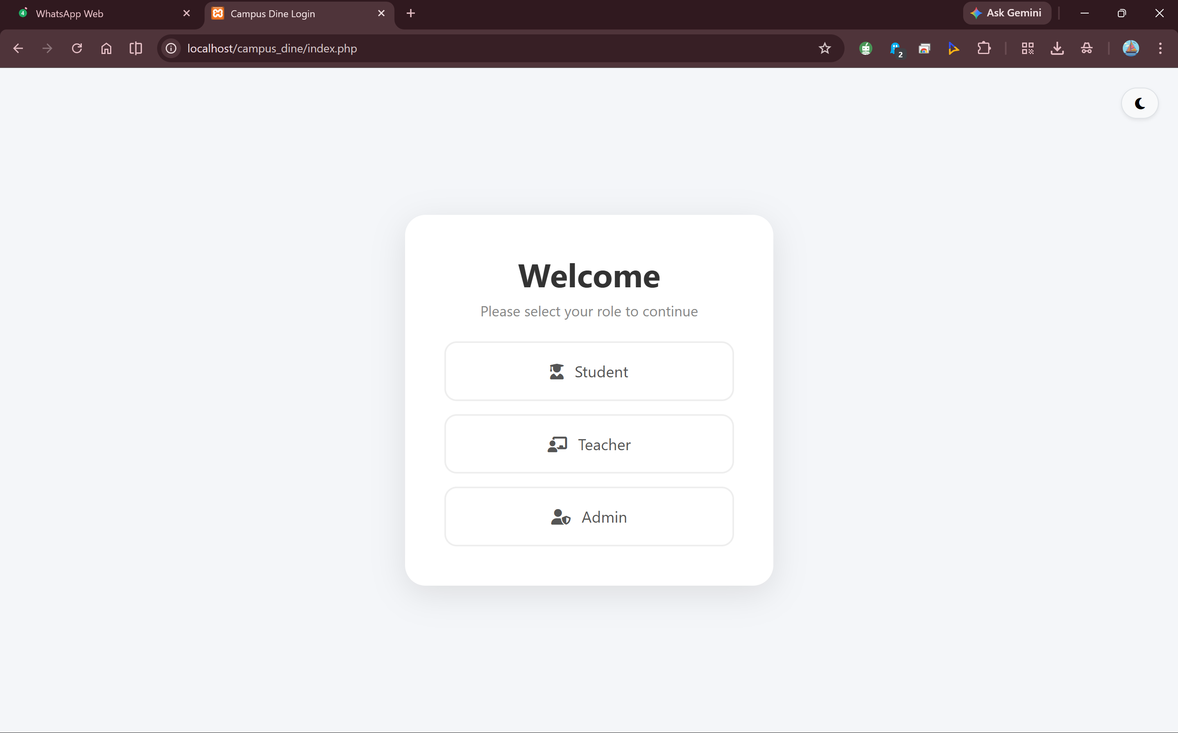
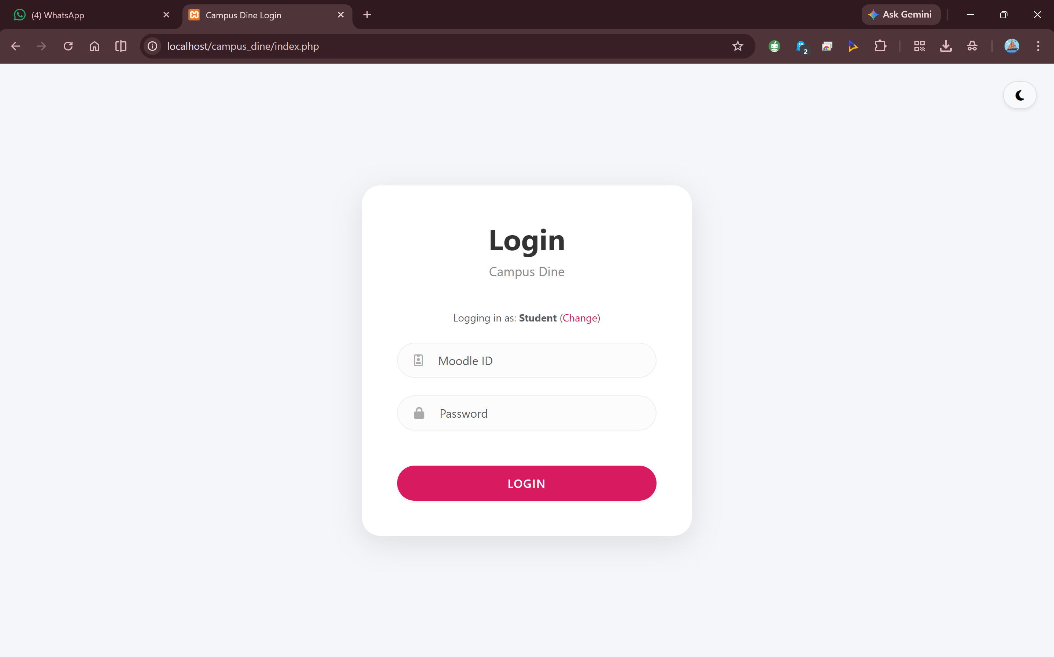
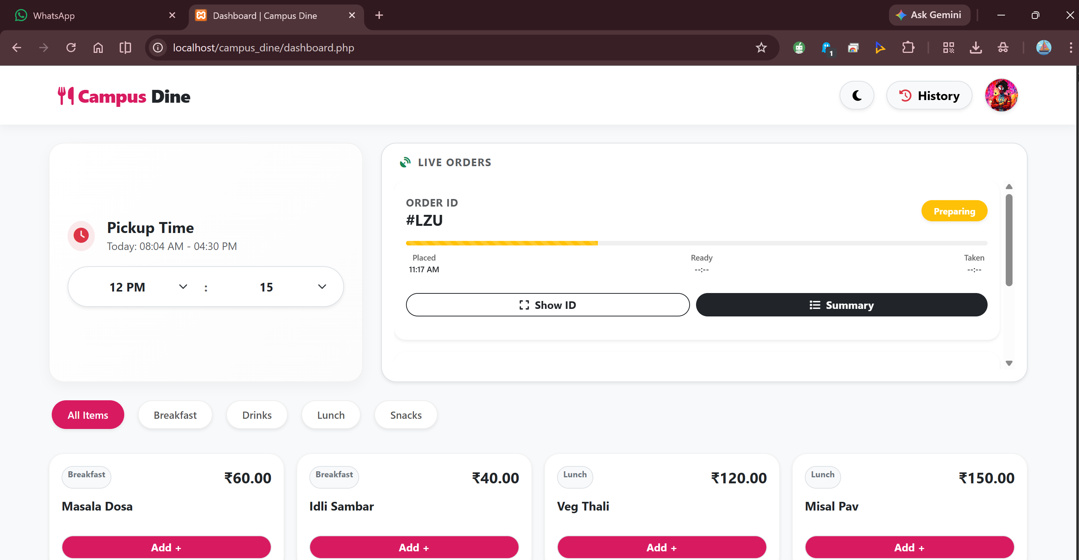
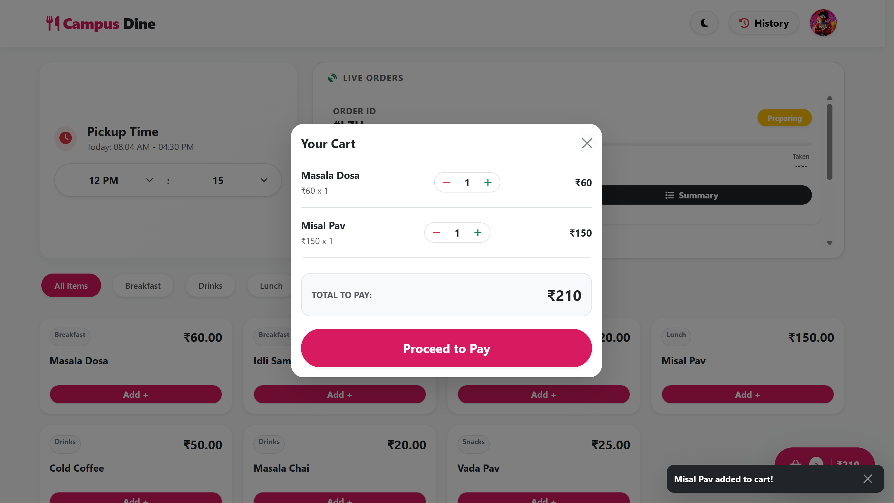
Implementation
Student Dashboard
Role Selection
Login Page
Menu and Time
Order Cart

Slide 12
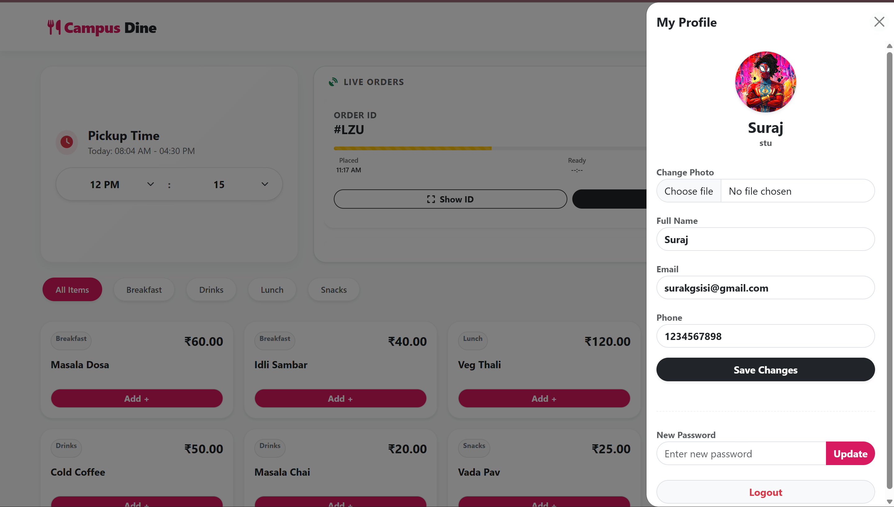
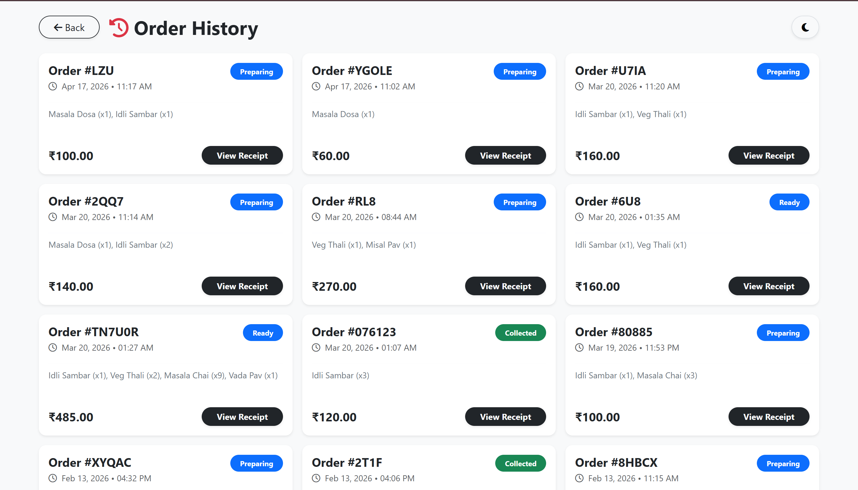
Implementation
Order History
Profile

Slide 13
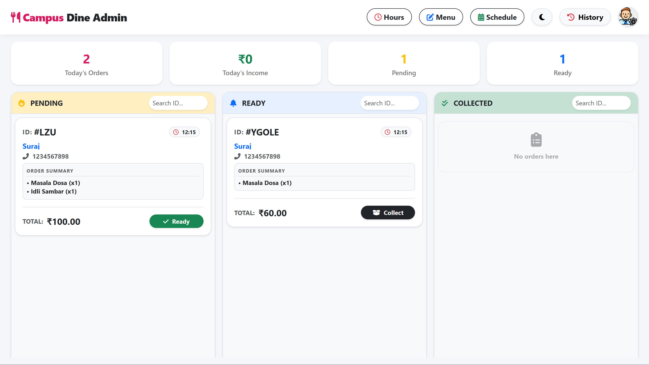
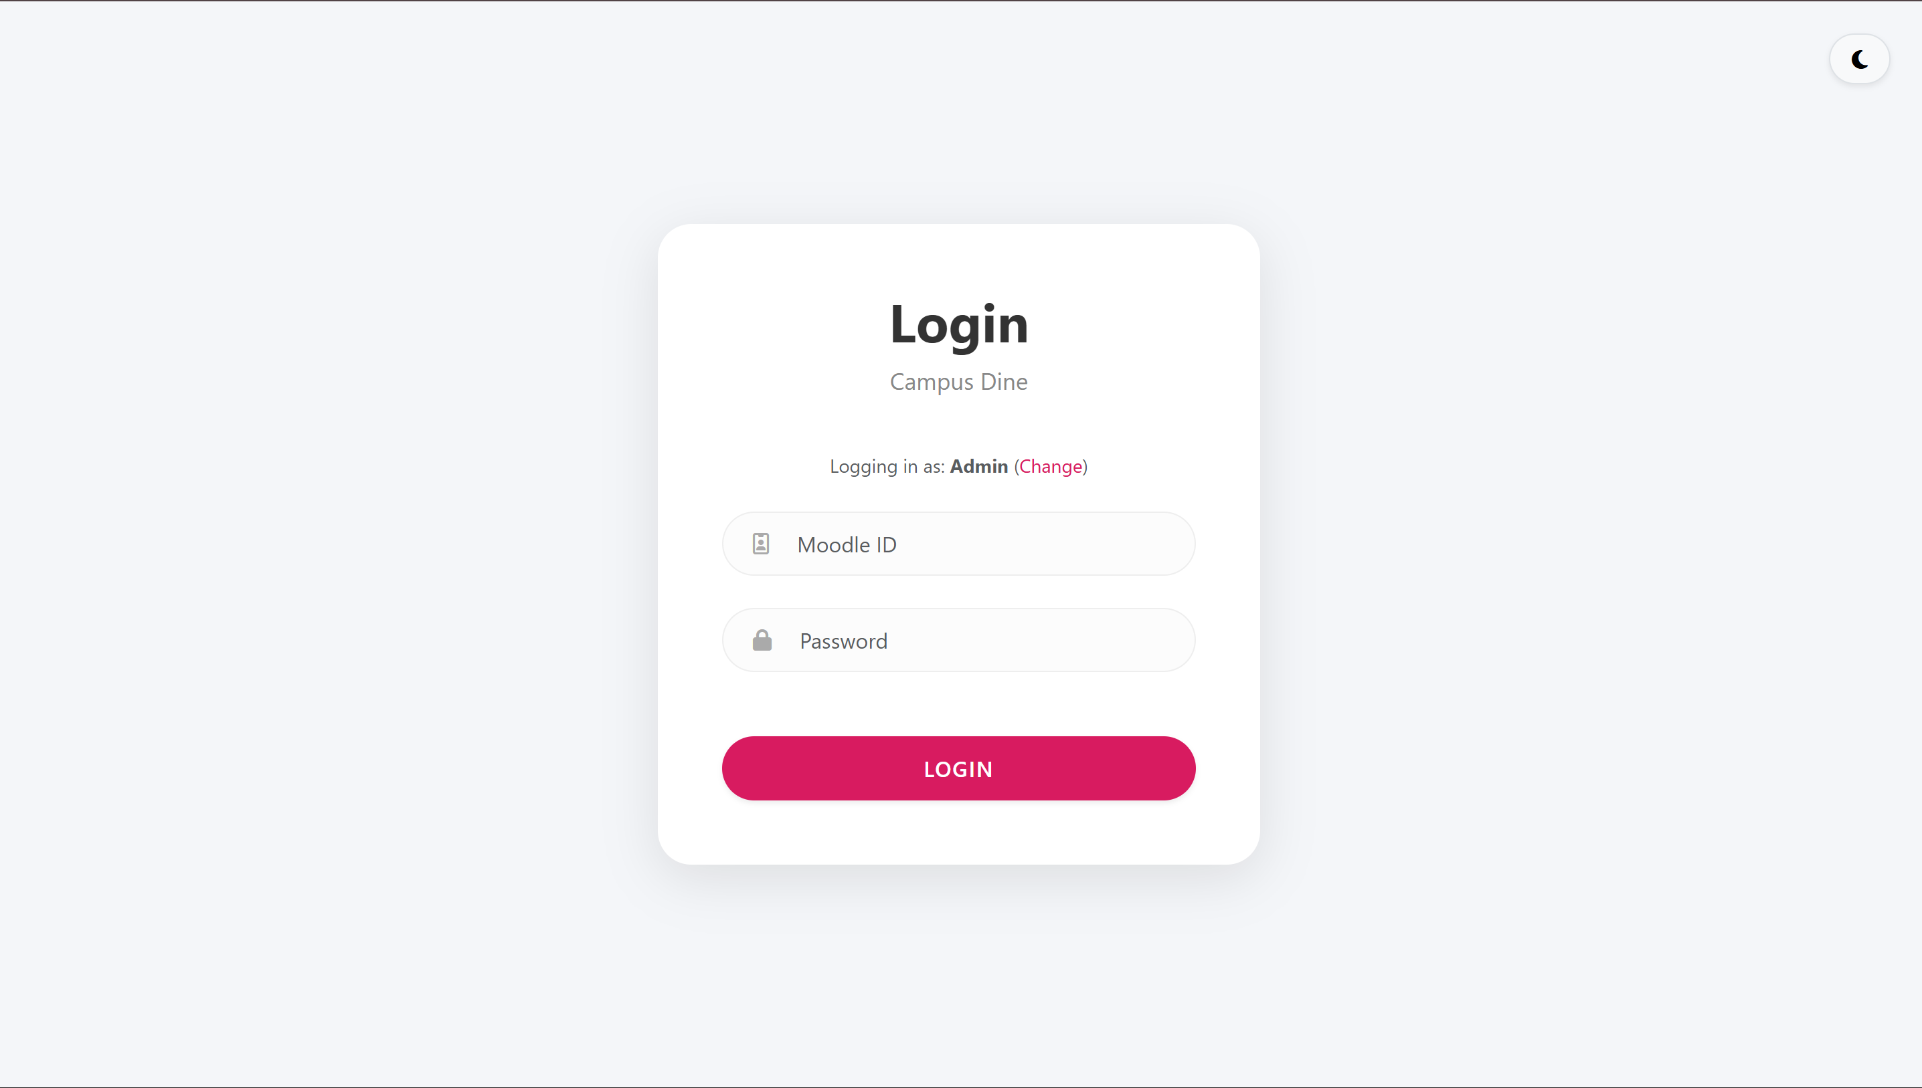
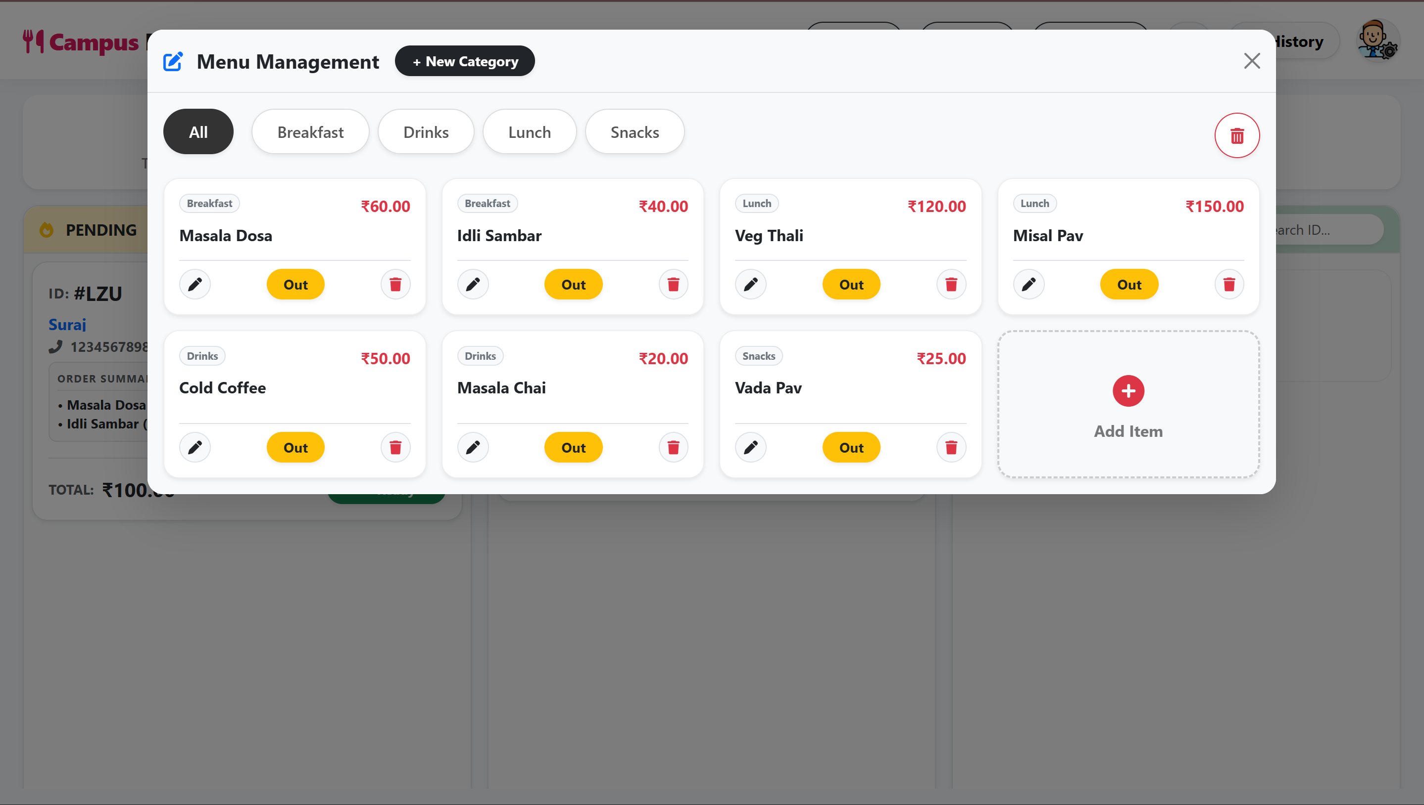
Implementation
Admin Dashboard
Login Page
Orders List
Menu Management

Slide 14
Results & Analysis
Performance Metrics (Key Results)
Order Processing Time: Reduced from 15 minutes (Manual) to 2 minutes (App).
Data Accuracy: 100% accuracy in billing and order recording (Zero calculation errors).
Usability :The system has a simple and easy interface that students and staff can use without training.
Real-Time Tracking Efficiency:Users can see live order status updates like Preparing, Ready, or Delivered.
Multi-Canteen Management:The system manages multiple canteens on one platform for easy control and updates.
Queue Reduction:Online ordering and pre-scheduling reduce crowd and waiting time at the counter.

Slide 15
References
[1] S. Bhattarai, S. K. Shrestha, and R. K. Sah, "QR Code Based Food Ordering System," Semantic Scholar, Corpus ID: 2458912, 2024. [Online]. Available: https://semanticscholar.org
[2] A. Katkar and S. Jangale, "Smart Canteen Management System using Android with E-Wallet," International Journal of Innovative Research in Computer and Communication Engineering (IJIRCCE), vol. 6, no. 2, pp. 120-125, 2018. Available: https://www.ijariit.com/manuscript/canteen-management-system-using- the-e-wallet/
[3] P. Bari, T. Suroshe, N. Sathawne, Y. Patil, and A. Patil, "Enhancing College Canteen Efficiency through Online Food Ordering: A Comprehensive Survey," Int. J. of Sci. & Research, vol. 13, no. 4, pp. 1-6, 2024. [Online]. Available: https://www.ijsr.net
[4] C. Antony, A. Biju, A. Kuriakose, A. Mathew, and J. M. U, "Canteen Food Ordering and Managing System," International Journal of Current Science Research and Review (IJCSRR), vol. 5, no. 6, pp. 2194-2199, Jun. 2022. DOI: 10.47191/ijcsrr/V5-i6-51. [Online]. Available: https://ijcsrr.org
[5] R. B. Kale, R. K. Balwade, and V. B. Gawai, "Online Food Ordering System for College Canteen," SAMRIDDHI: A Journal of Physical Sciences, Engineering and Technology, vol. 12, no. Sup 2, pp. 64-68, Nov. 2020. DOI: 10.18090/samriddhi.v12iS2.13. [Online]. Available: https://smsjournals.com

Slide 16
Thank You...!!

